Slide 1
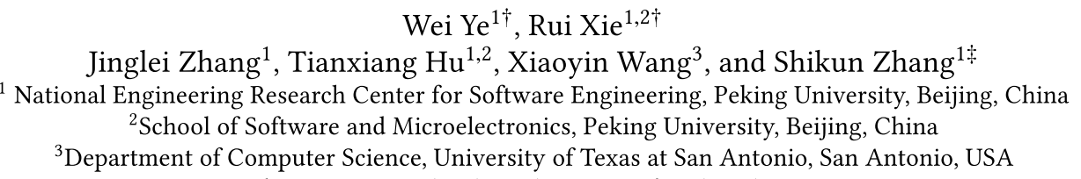
Leveraging Code Generation to Improve Code Retrieval and Summarization via Dual Learning
WWW-2020
Fang Liu
2020/3/11

Slide 2
Introduction
During software development and maintenance, developers often spend lots of time understanding code and searching for the code snippets they need.
A large amount of code and related text information have been accumulated on the Web. These datasets have greatly contributed to the progress of research on code retrieval and code summarization.
Since both code retrieval and code summarization tasks aim to model the association between natural language and programming language, recent studies have combined these two tasks to improve their performance.

Slide 3
Introduction
Existing solutions:
BVAE [1], a neural framework that contains two Variational-Auto-Encoders (VAEs) to model source code and natural language respectively.
CoaCor [2], trained a code summarization model to generate code summaries that can be used for the retrieval task based on reinforcement learning
Lead to two problems:
Performance cannot be well balanced between code retrieval and code summarization.
The complexity of overall procedure makes the model training more challenging.
[1] A neural framework for retrieval and summarization of source code. (ASE-2018)
[2] CoaCor: Code Annotation for Code Retrieval with Reinforcement Learning. (WWW-2019)

Slide 4
Introduction
To overcome these issues, we propose an easy-to-train, end-to-end method to improve both code retrieval and code summarization.
Introduce an additional code generation task:
Exploit the probabilistic correlation between code summarization and code generation with dual learning.
The two encoders for code summarization and code generation are also shared with a code retrieval scorer via multi-task learning

Slide 5



Background
Code Retrieval
given a set of code snippets $X$ and a natural language query $y$, code retrieval aims to retrieve the corresponding code snippet $x$ ∈ $X$ that matches the semantics of the query $y$.
Source code encoder
Natural language encoder
$$V_{x}=E_{x}(x)$$
$$V_{y}=E_{y}(y)$$
Compute similarity:
$$Similarity=S(V_{x},V_{y})$$
By maximizing the similarity function, we can get the most relative code to a given description.

Slide 6


Background
Code Summarization and Code Generation
code summarization and code generation are dual tasks of each other.
Code Summarization
Given an input code snippet $x={(x}_{1},x_{2},…,x_{m})$, code summarization aims to generate a readable natural language query $x={(y}_{1},y_{2},…,y_{n})$ which describe the input code snippet $x$.
Code Generation

Slide 7
Background
Dual Learning
utilize the duality so that two dual tasks can keep learning from each other until convergence.
a primal task: takes samples from space X as input to map into output space Y
a dual task: takes samples from space Y as input to map to output space X.
for n training pairs ${\left(x_{i},y_{i}\right)}_{i=i}^{n}$ the primal task is to find function $f:X ↦Y$ , and the dual task is to find function $f:Y ↦X$
probabilistic duality:

Slide 8
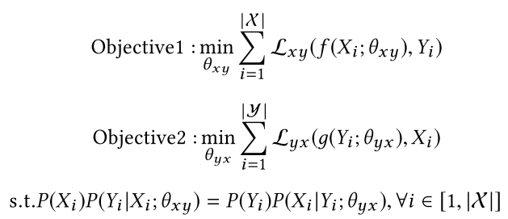
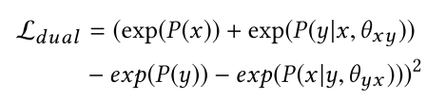
Background
Dual Learning
By incorporating dual learning into specific training objectives of deep learning models, we would have:
To optimize these training objectives, the common practice in dual learning is to introduce Lagrange multipliers and add the equality constraint of probabilistic duality into the objective functions.
Notes:
Convert the probabilistic duality constraint into the following regularization term

Slide 9
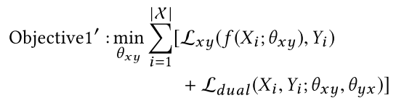
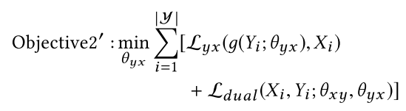
Background
Dual Learning
the training objectives become:
utilize this regularization term to restrain code summarization and code generation to achieve a better performance.

Slide 10
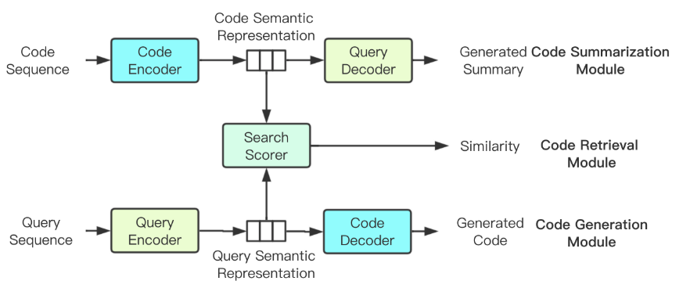
Approach
The code summarization module encodes the code sequence x, and summarizes it into a text sequence y′.
The code generation module encodes the text sequence y, and uses it to generate a code sequence x′.
The code retrieval module calculates similarity scores between the hidden states of the code summarization module and the code generation module, and then retrieves matching source code based on the scores.

Slide 11
Approach
two major features:
Add a restriction between the code summarization module and the code generation module with dual learning method to connect them and help capture more intrinsic and precise representations of text and code.
Share the parameters of LSTM cells between the encoder of the code summarization module and the decoder of the code generation module, so do the decoder of the code summarization module and the encoder of the code generation module.
Notes:
This reduces the number of model parameters. In this way, we use only two LSTM instances for the three tasks, constructing an extremely simple model.

Slide 12
Approach
Code Summarization Module
Encoder: Bi-LSTM
Decoder: LSTM
attention mechanism
Code Generation Module
The whole structure is basically the same as the code summarization module.
Sharing parameters
Code: code generation decoder and the code summarization encoder
Natural language: code generation encoder and the code summarization decoder

Slide 13

Approach
Dual Learning for Code Summarization and Generation
Restrict these two modules by the following equation:
P(y|x) and P(x|y) can be calculated by the code summarization module and the code generation module.
P(x) and P(y) are marginal distributions which cannot be directly calculated, so we use language models to fit their real values.

Slide 14

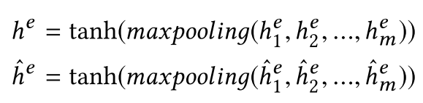

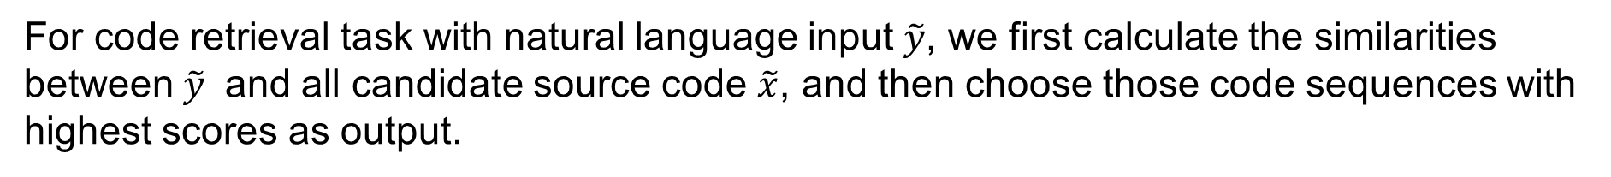
Approach
Code Retrieval Module
For code retrieval task with natural language input $\tilde{y}$, we first calculate the similarities between $\tilde{y}$ and all candidate source code $\tilde{x}$, and then choose those code sequences with highest scores as output.
similarity score:
$h^{e},{\hat{h}}^{e}$ is calculated by the encoders’ hidden states in the code summarization module and the code generation module when they take $\tilde{x}$ and $\tilde{y}$ as input:

Slide 15
Approach
Code Retrieval Module
use Ranking Loss to define the training objective
For a paired sample $(x,y)$, we randomly choose another source code input $x^{r}$ and a text summary $y^{r}$, and we assume the score of pair $(x,y)$ is higher than that of pair ($x^{r}$, $y^{r}$) with a margin of at least $M_{cr}$. So the loss function is:

Slide 16
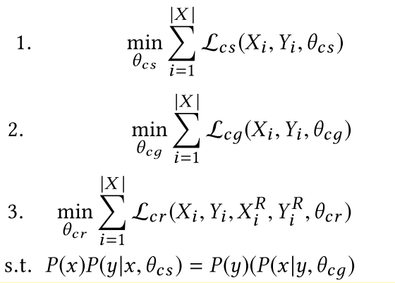


Approach
Training
The final training objectives are:
where $x^{r}$and $y^{r}$ in $X^{R}$ and $Y^{R}$ are randomly sampled from X and Y.
minimizing the weighted combination of the original loss functions and the added regularization term (to CS and CG).

Slide 17
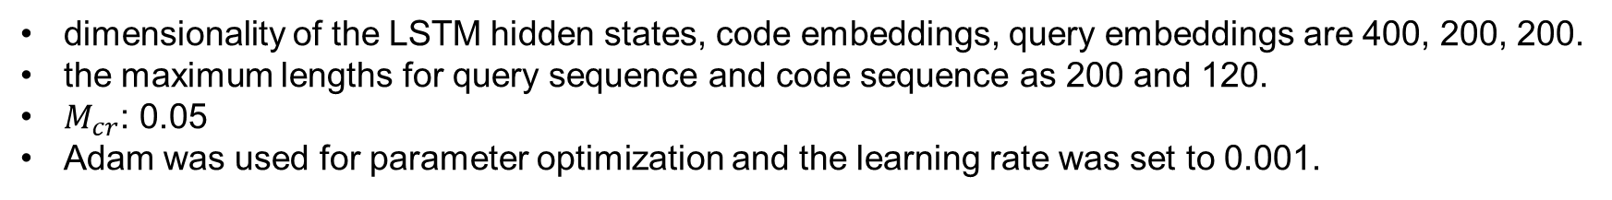
Experiments
Details of Datasets
dataset StaQC [1], which contains data of two different programming languages—SQL and python
It contains 119,519 and 147,546 <question title, code> pairs in SQL and Python respectively, which were mined from Stack Overflow.
75% of the pairs for training, 10% for validation and 15% for testing.
Implementation Details
dimensionality of the LSTM hidden states, code embeddings, query embeddings are 400, 200, 200.
the maximum lengths for query sequence and code sequence as 200 and 120.
$M_{cr}$: 0.05
Adam was used for parameter optimization and the learning rate was set to 0.001.
[1] StaQC: A Systematically Mined Question-Code Dataset from Stack Overflow (WWW-2018)

Slide 18
Experiments
Evaluation Metrics
Code retrieval
MRR and NDCG
Code Summarization.
BLEU and METEOR
Notes:
It is similar to MRR but with different distribution of weights on each item

Slide 19
Experiments
Baselines
Code retrieval
DCS [1]: a deep code search model which uses two deep neural networks to encode source code and natural language description into vector representation, and then uses a cosine similarity function to calculate their similarity.
CoaCor [2]: trained a code summarization model to generate code summaries that can be used for the retrieval task based on reinforcement learning
Code Summarization.
CODE-NN [3] is an end-to-end code summarization approach.
Seq2Seq: is a basic encoder-decoder model. Bi- LSTM for the encoder and LSTM for the decoder, and the attention mechanism is applied in each decoding step.
CoaCor [2].
[1] Deep code search. (ICSE-2018)
[2] CoaCor: Code Annotation for Code Retrieval with Reinforcement Learning. (WWW-2019)
[3] Summarizing Source Code using a Neural Attention Model. (ACL-2016)

Slide 20
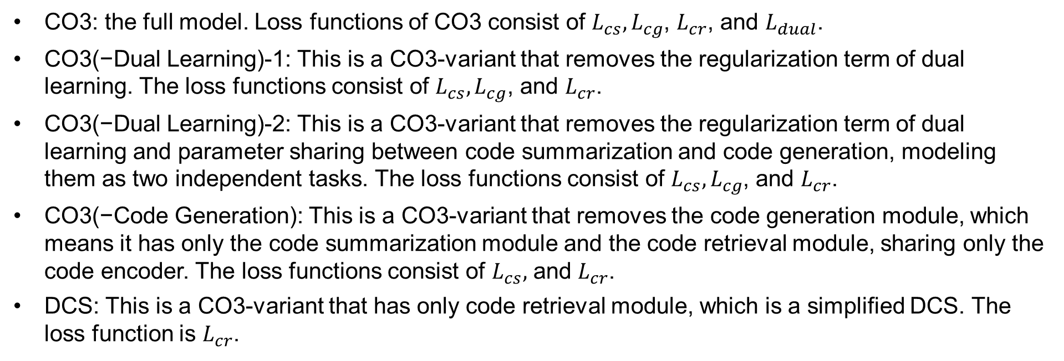
Experiments
CO3 Variants
CO3: the full model. Loss functions of CO3 consist of $L_{cs},L_{cg}$, $L_{cr}$, and $L_{dual}$.
CO3(−Dual Learning)-1: This is a CO3-variant that removes the regularization term of dual learning. The loss functions consist of $L_{cs},L_{cg}$, and $L_{cr}$.
CO3(−Dual Learning)-2: This is a CO3-variant that removes the regularization term of dual learning and parameter sharing between code summarization and code generation, modeling them as two independent tasks. The loss functions consist of $L_{cs},L_{cg}$, and $L_{cr}$.
CO3(−Code Generation): This is a CO3-variant that removes the code generation module, which means it has only the code summarization module and the code retrieval module, sharing only the code encoder. The loss functions consist of $L_{cs},$ and $L_{cr}$.
DCS: This is a CO3-variant that has only code retrieval module, which is a simplified DCS. The loss function is $L_{cr}$.

Slide 21
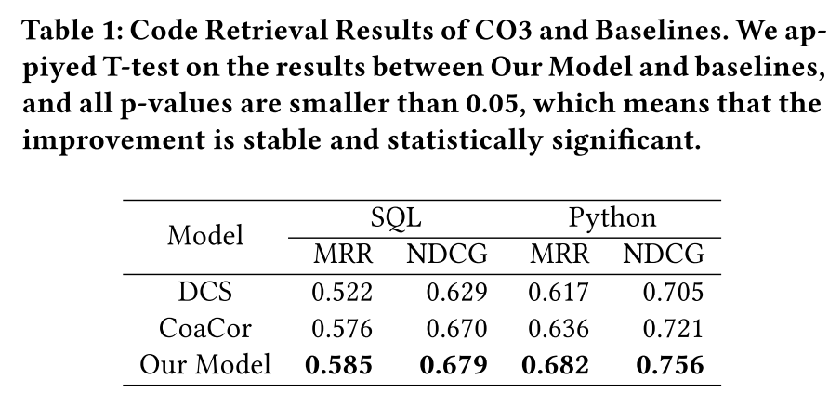
Results
Performance of Code Retrieval

Slide 22
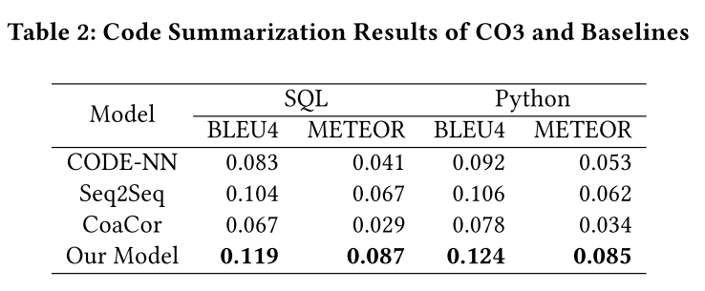
Results
Performance of Code Summarization
CoaCor prefers to generate code summary with longer length, which contains more conceptual words for code retrieval and thus weakens human readability.

Slide 23
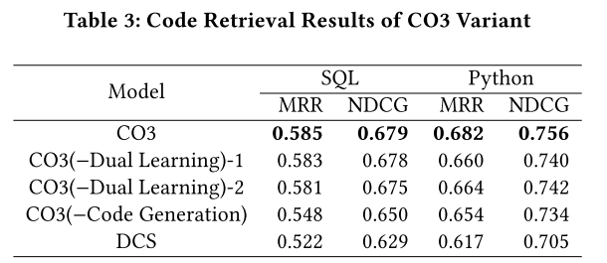
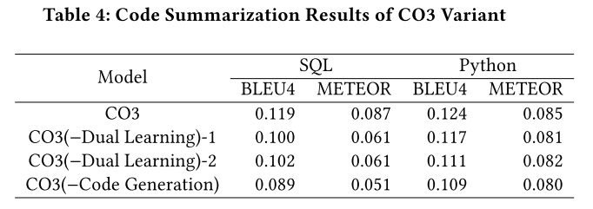
Results
Effect of Code Generation Task
the code generation task can be helpful even without dual learning.
whether sharing LSTM parameters for dual learning or not does not have too much effect on the performance.

Slide 24
Results
Effect of Dual Learning
Compared with code retrieval, the improvement caused by dual learning for code summarization is larger.

Slide 25
Results
Effect of Multi-task Learning
Compared to DCS

Slide 26
Conclusion
+ Approach is simple and several tasks can be learned simultaneously.
Novelty is limited
Improvements are limited
Baselines are simple

Slide 27
Thanks !

